Slide 1
Front-End Web Development Using React (Client Side Technologies - JavaScript)
Front-End Web Development Using React – JS
Eng. Reem Hassan Ahmed

Slide 2
06
DOM and BOM
Front-End Web Development Using React – CSS

Slide 3
Events
JavaScript is an event-driven language.
Types of different events:
Mouse Events
Keyboard Events
Form Events
Other

Slide 4
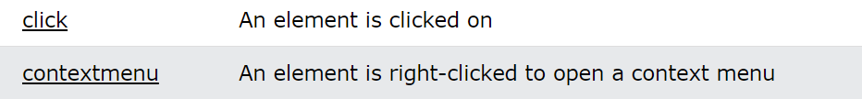
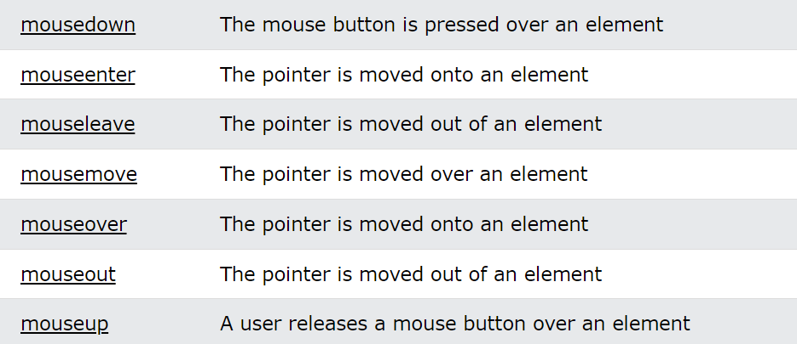
Mouse events
The mouseover event triggers when the mouse pointer enters the div element, and its child elements. The mouseenter event is only triggered when the mouse pointer enters the div element.

Slide 5
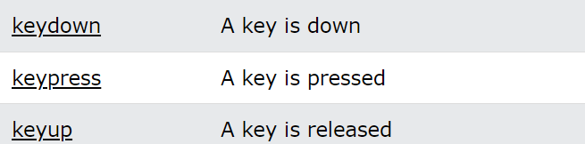
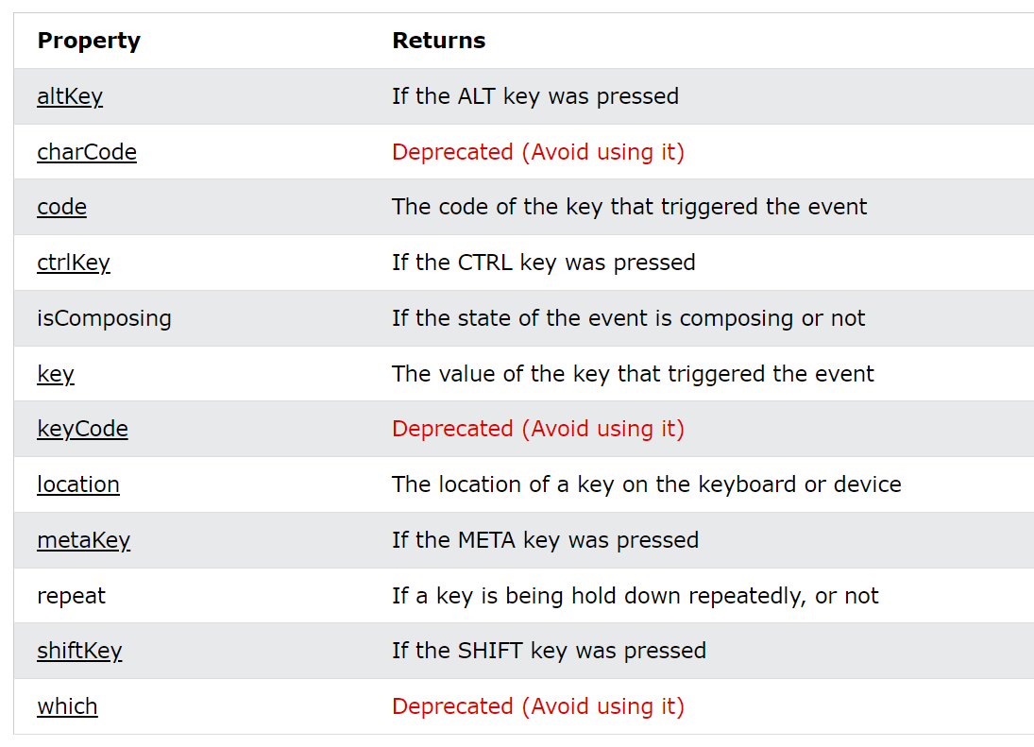
Keyboard events

Slide 6
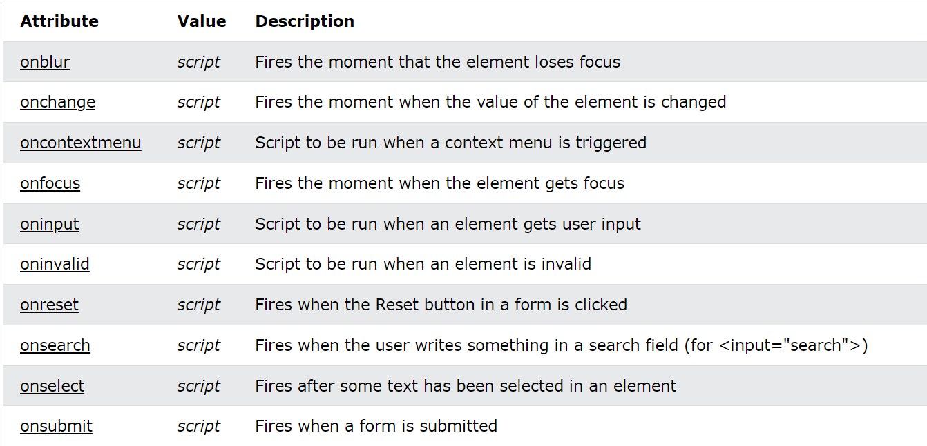
Forms events

Slide 7

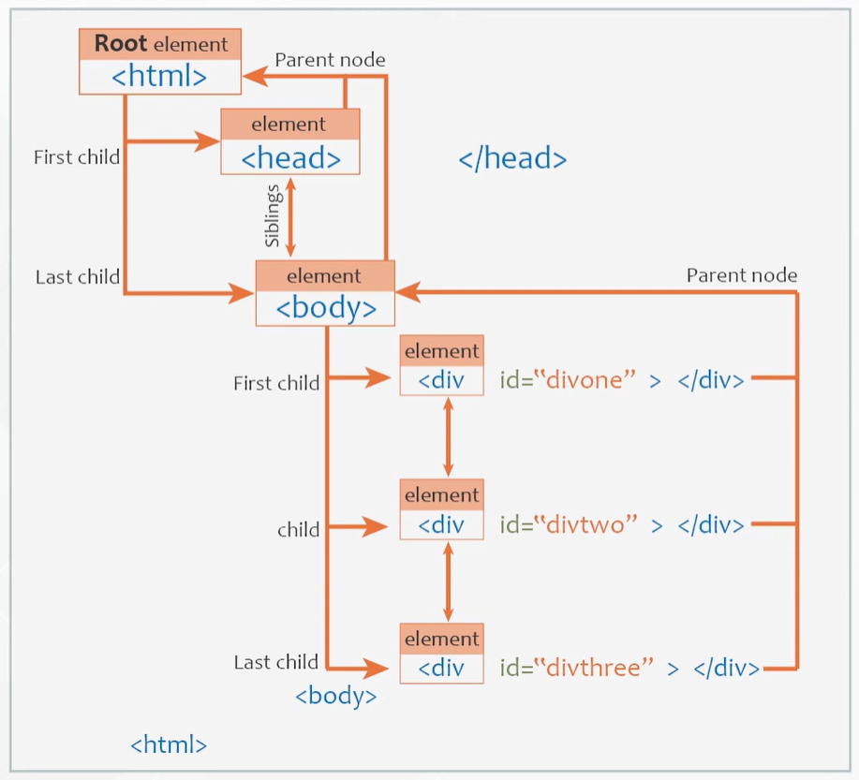
What is DOM?
When a web page is loaded, the browser creates a Document Object Model of the page.
The HTML DOM model is constructed as a tree of Objects:

Slide 8
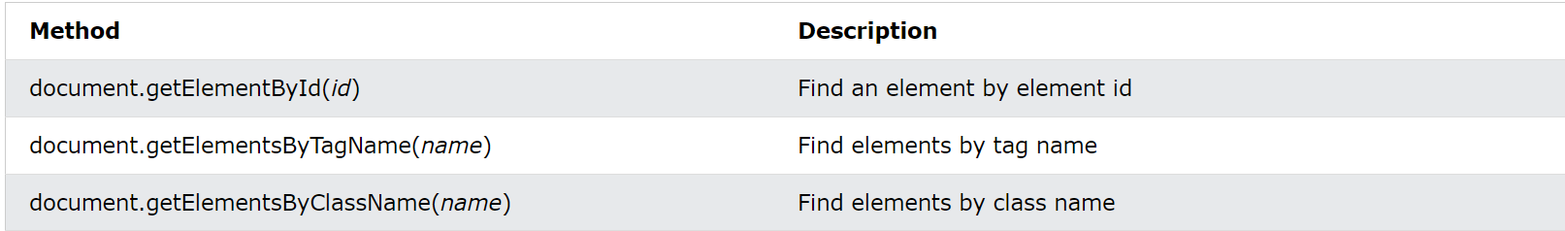
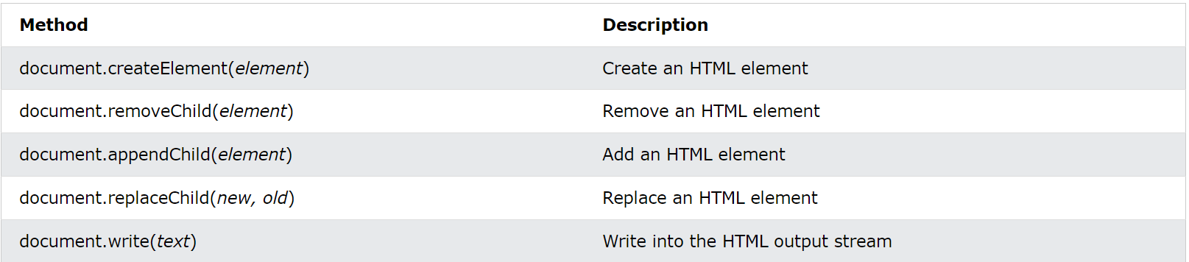
DOM methos

Slide 9
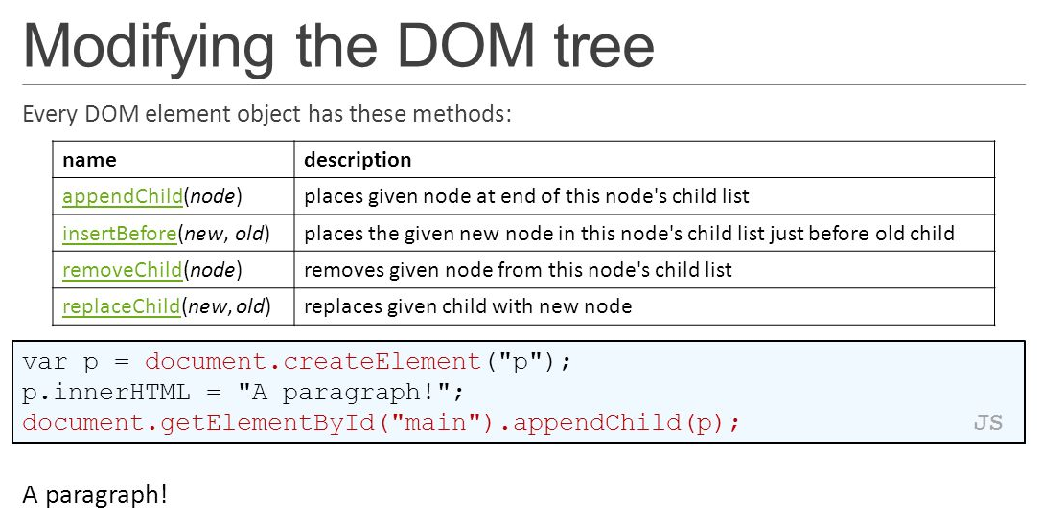
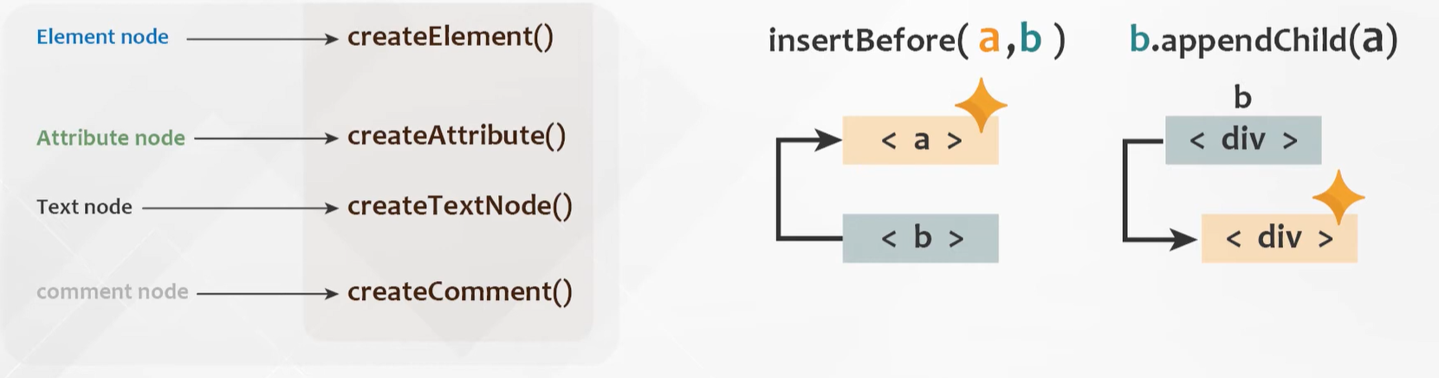
DOM methos Cont.

Slide 10
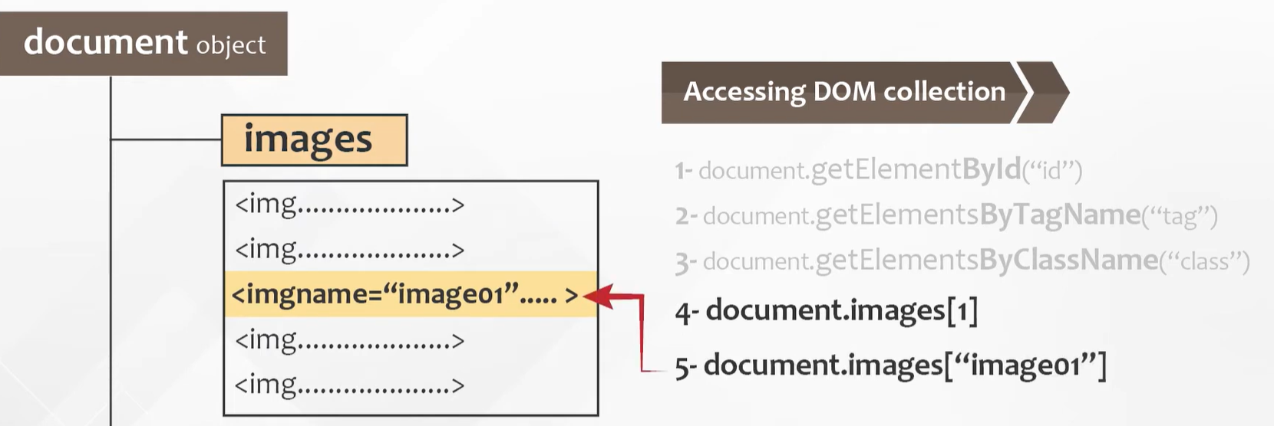
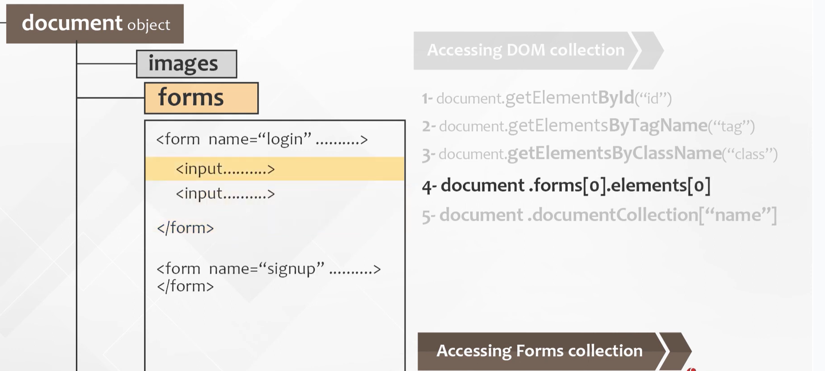
DOM collection

Slide 11
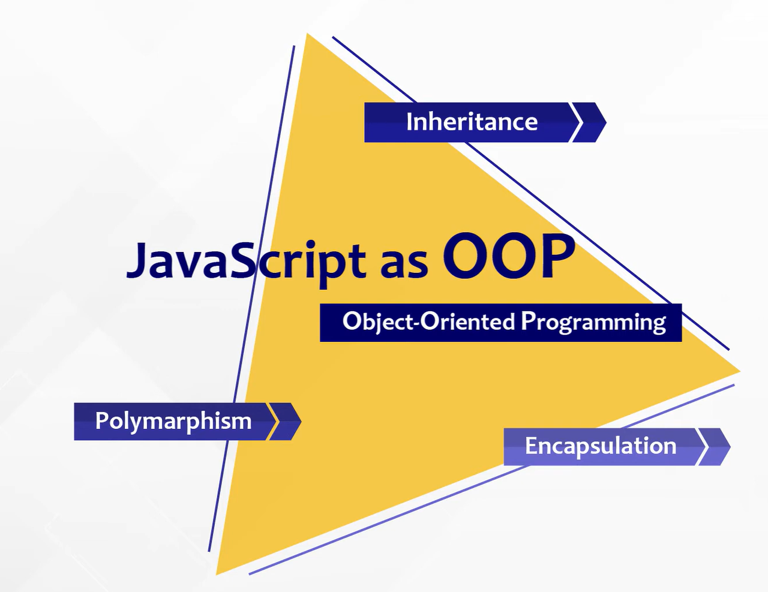
OOP
JavaScript doesn’t have the class concept, even though there’s class keyword in ES6.
In JavaScript classes are functions.

Slide 12
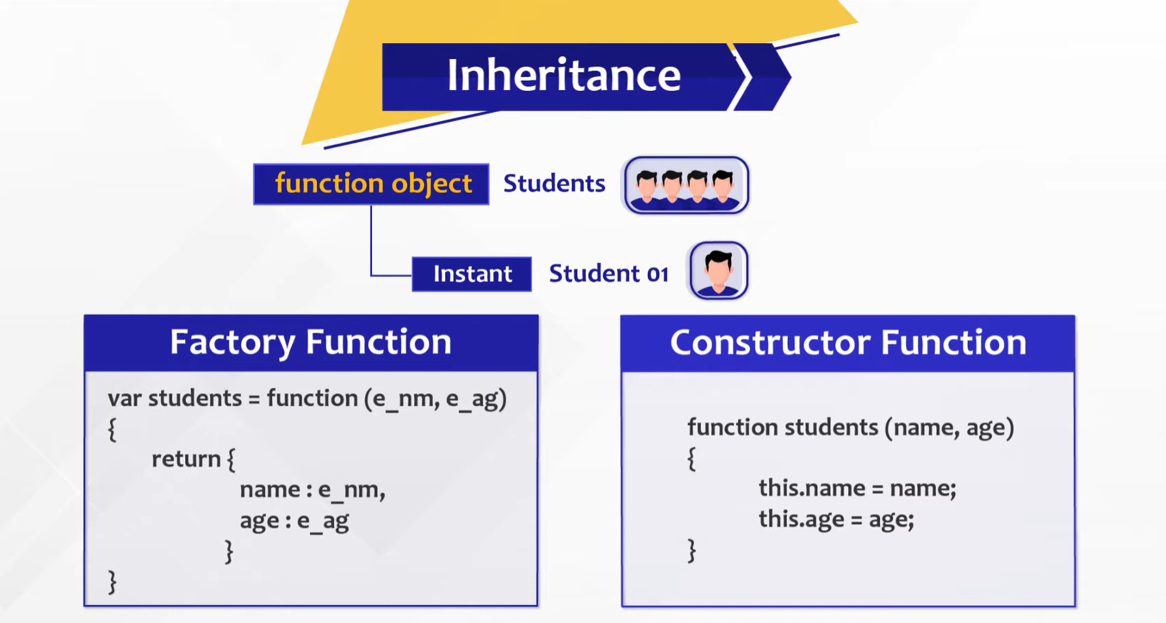
OOP Cont.

Slide 13
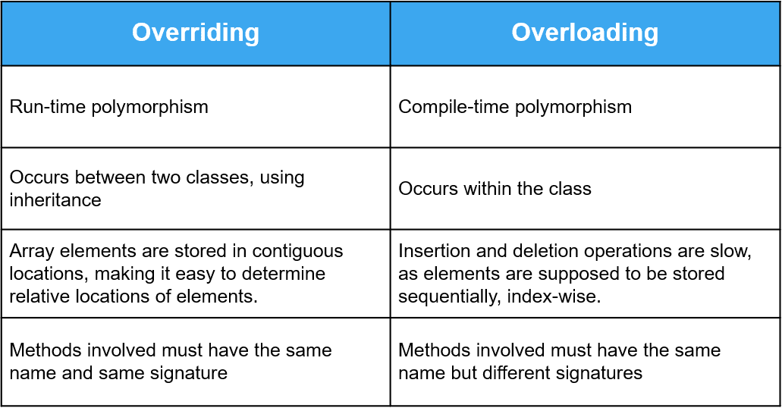
OOP Cont.

Slide 14
Thanks!
Front-End Web Development Using React – CSS
Does anyone have any question?
ReemHassan160299@gmail.com
+201092427577
Please keep this slide for attribution

